Slide 1
SCHOOL OF ENGINEERING, ELECTRICAL AND ELECTRONIC ENGINEERING
NETWORKS 4_ Week C_
Ronald van Buuren
April 2023

Slide 2
net4 program by week
1st order RC networks – discharging – DC source
1st order RC networks – charging –DC source
RL networks – Steady-state DC
RL networks – Switched DC source
RC & RL networks – complementary solution
<spare week>
Sample Exam

Slide 3
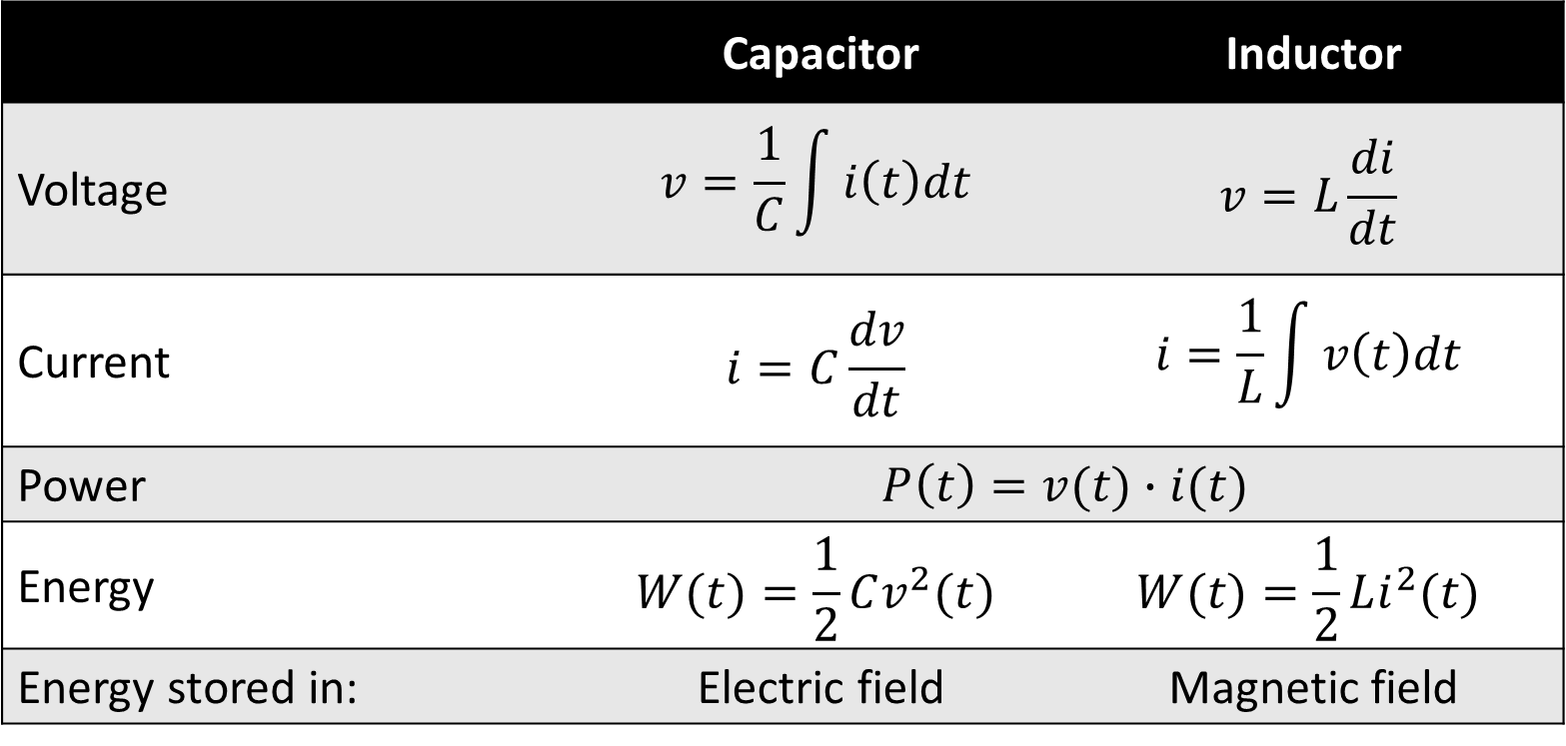
Capacitor & inductor relations
 | Capacitor | Inductor
Voltage | $$v=\frac{1}{C}\int{i\left(t\right)dt}$$ | $$v=L\frac{di}{dt}$$
Current | $$i=C\frac{dv}{dt}$$ | $$i=\frac{1}{L}\int{v\left(t\right)dt}$$
Power | $$P\left(t\right)=v(t)∙i(t)$$
Energy | $$W(t)=\frac{1}{2}Cv^{2}(t)$$ | $$W(t)=\frac{1}{2}Li^{2}(t)$$
Energy stored in: | Electric field | Magnetic field

Slide 4
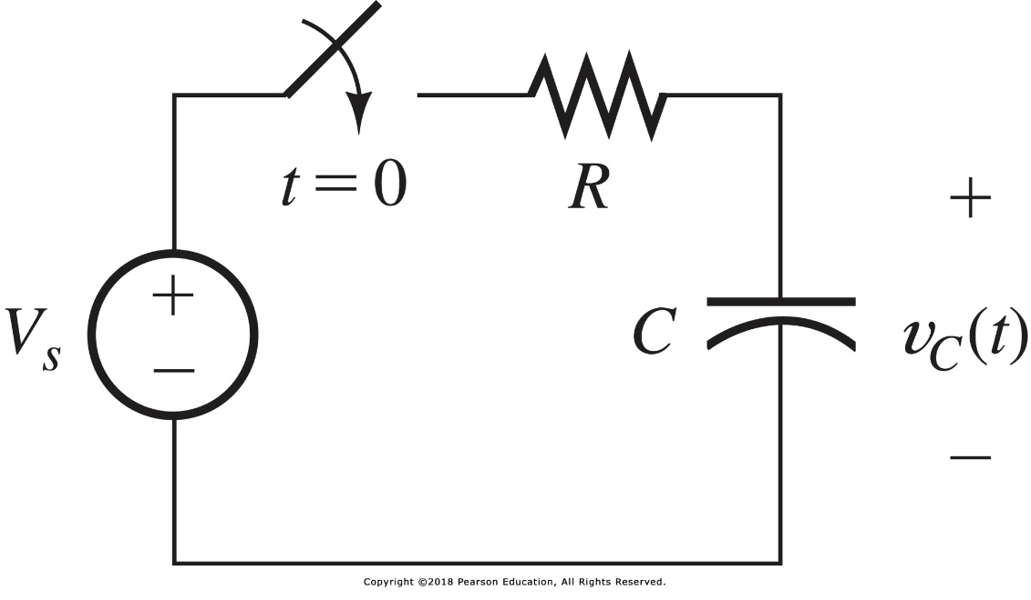
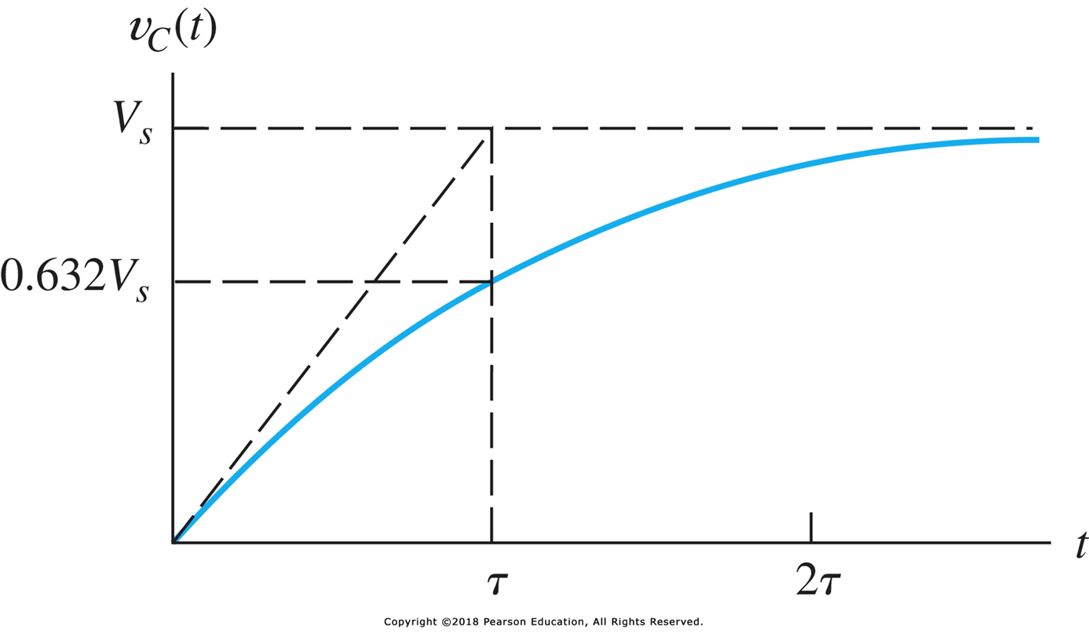
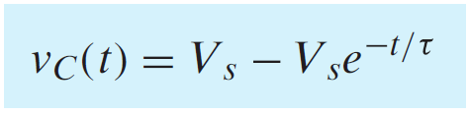


week B: charging a capacitor

Slide 5
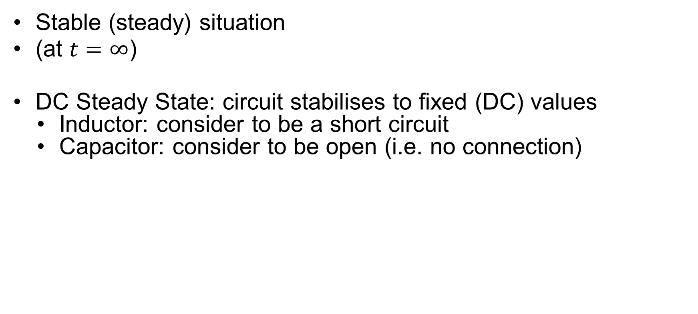
Steady State
Stable (steady) situation
(at $t=∞$)
DC Steady State: circuit stabilises to fixed (DC) values
Inductor: consider to be a short circuit
Capacitor: consider to be open (i.e. no connection)

Slide 6
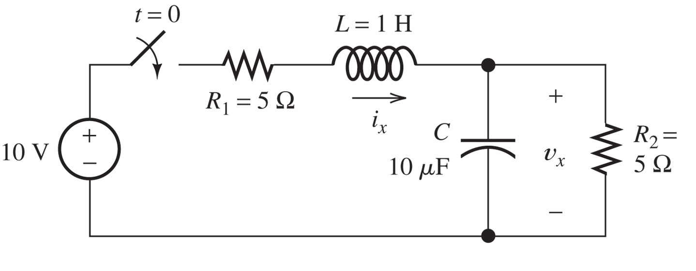

example: DC Steady State
At $t=0$ we close the switch
Hoe groot zijn i_{x} en v_{x} op $t=∞$?

Slide 7
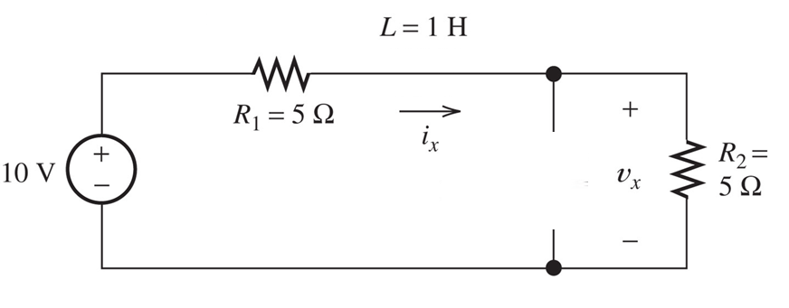
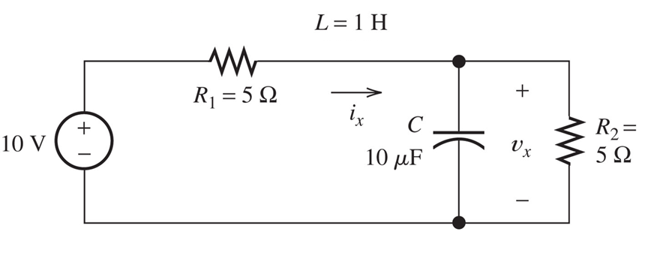

example solved:
Equivalent circuit at $t=∞$
i_{x} = V / (R₁ + R₂) = 1 A
v_{x} = R₂ / (R₁ + R₂) x V = 5 V (voltage division)

Slide 8
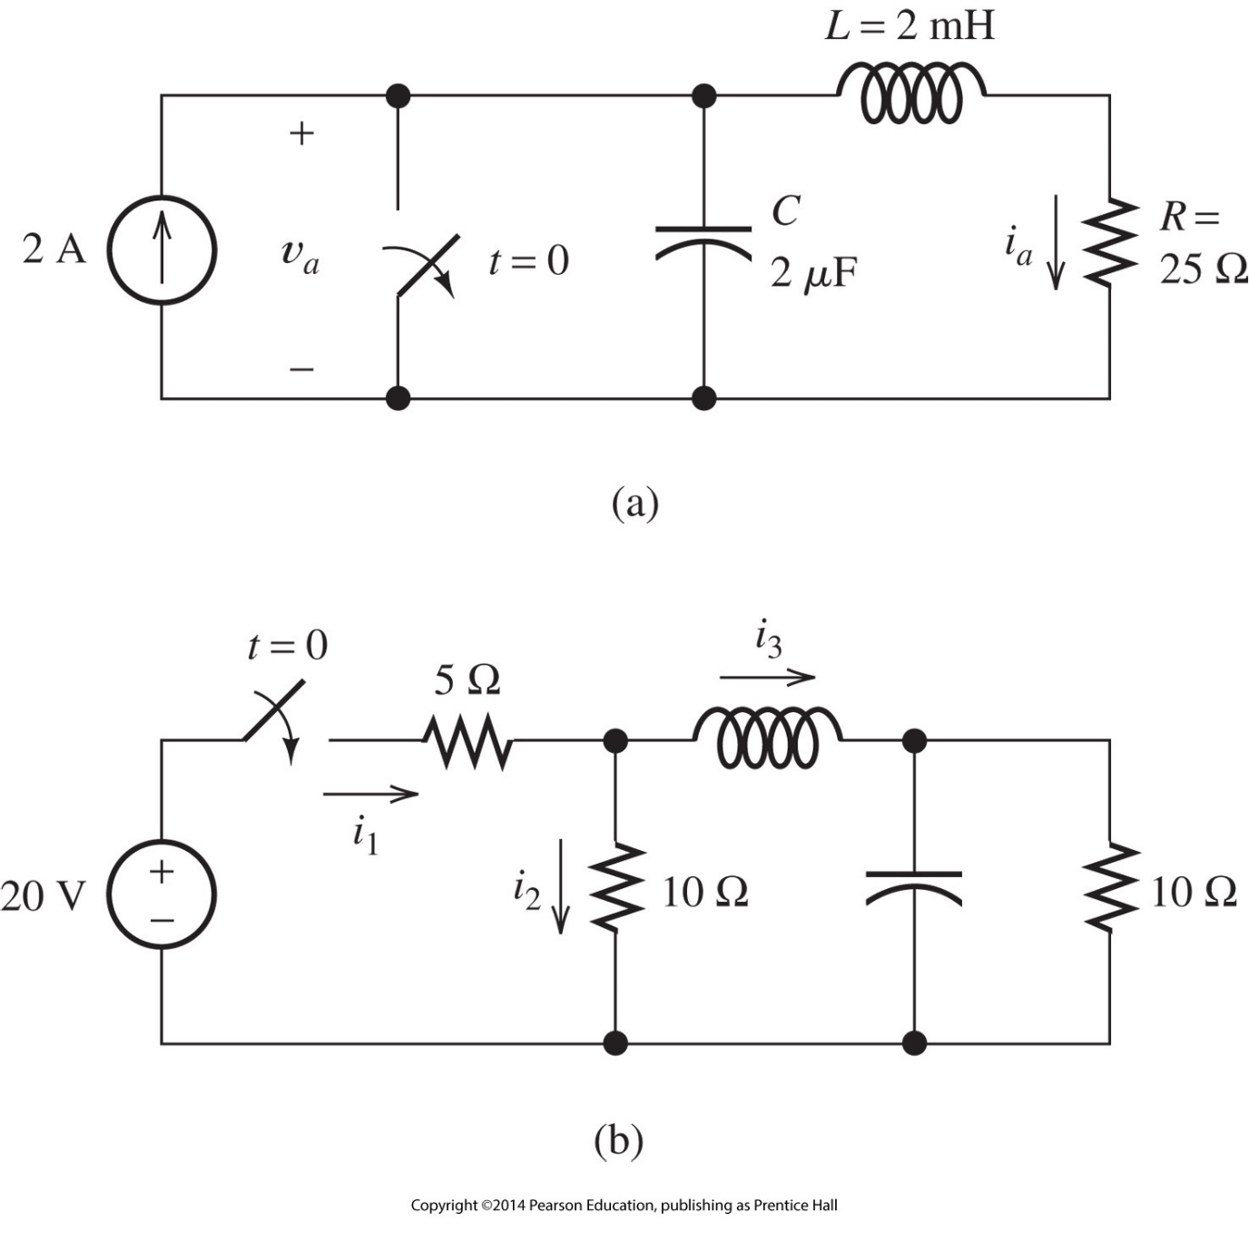
exercise (1)
Find the DC Steady-state values of v_{a} and i_{a}:

Slide 9
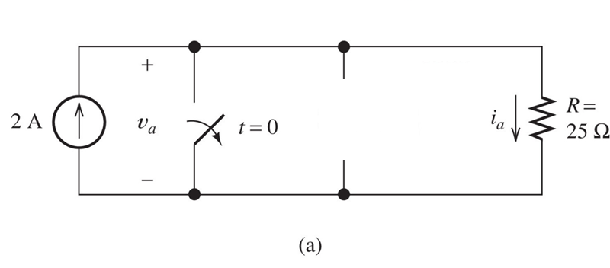
exercise (1) solved
Find the DC Steady-state values of v_{a} and i_{a}:

Slide 10
exercise (2)
Find the DC Steady-state values of i₁ and i₂:

Slide 11
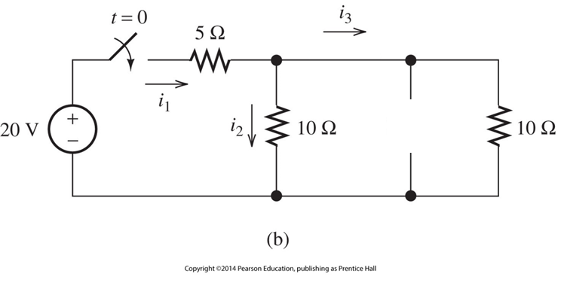
exercise (2) solved
Find the DC Steady-state values of i₁ and i₂:

Slide 12
problems for this WEEK
P4.22
P4.23
P4.25
P4.28
P4.30

